Slide 1
EPICS: The Social of Greenwood
Team Members: Sean Gibbens, Chris McDonald, and Ade Oluyedun

Slide 2
Brief Client Description
The Social of Greenwood
Opportunity for seniors to get involved in community activities
Located in Greenwood but serves surrounding counties
Contacts: Bob Goodrum and Patric McDowell

Slide 3
Gathering Requirements
Initial notes
Meeting with Points of Contact
Establish what was needed, what was desired

Slide 4
Goals
Make a Chronological list of Tasks
Deem what material should be kept on TSOG site
Quickly Establish which platform to utilize

Slide 5
Wordpress Design
Website platform: Wordpress
Why use Wordpress?
Wordpress is a highly adaptive and functional CMS
Wordpress runs using the popular functional language PHP
The popularity and open-source nature of Wordpress create an easy-to-use platform for developing a website
The Wordpress UI allows non-tech-savvy individuals to manage their website with ease
The first step was to choose a theme: zAlive
This particular theme is extremely customizable, modern and provides an option for a responsive site
The zAlive theme implements Bootstrap
Bootstrap is a framework that uses standard HTML and CSS code with scaling modifications which can be used for creating a responsive website that works across multiple mobile platforms (iphone, android, ipad, etc)
The second step involved transferring all of the content deemed necessary from the original site
Once the content was transferred, we began working on the design of the website.

Slide 6
Website Design
The goal for the design of the website was to provide an aesthetically pleasing and enjoyable place for members and visitors to find out more about The Social of Greenwood
The majority of the website is run by scripts of PHP code
PHP is a server-side scripting language used for website development
For the design, we programmed using HTML and CSS which is incorporated into the PHP code
HTML is a markup language mainly used for text that allows for customization
CSS is a styling language used to control the format and design of the HTML code
Both are considered to be client-side ‘scripting’ languages
In the style.css file, we were able to change the format of the website
Changes included colors, sizes, the positioning of objects of the website
Color scheme: Light on dark with the closest color we could find to the logo for TSOG (#4e8975) - Sea Green
The functionality of the website we implemented didn’t require any hard coding into the PHP files due to the options present in the zAlive theme, but the next phase of the project will require a lot of modifying to the PHP code running the site (database interaction, modifications to current options, etc)

Slide 7
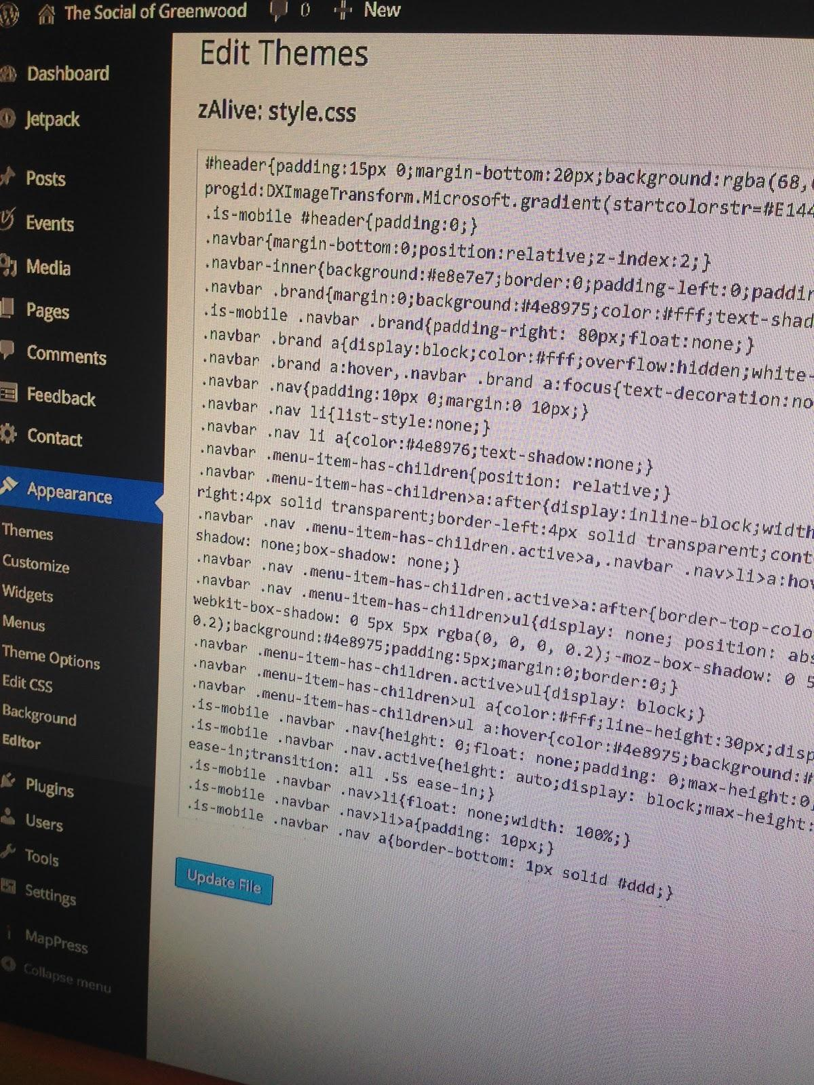
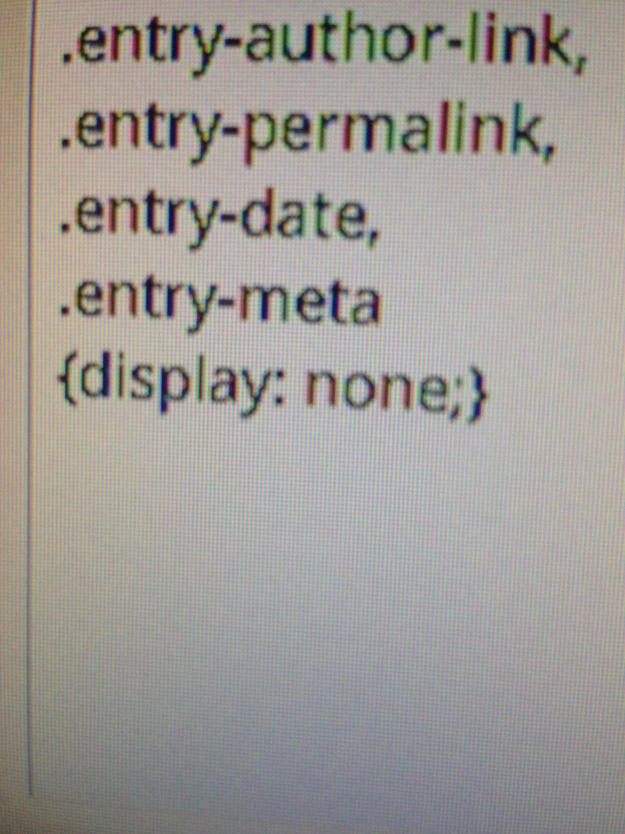
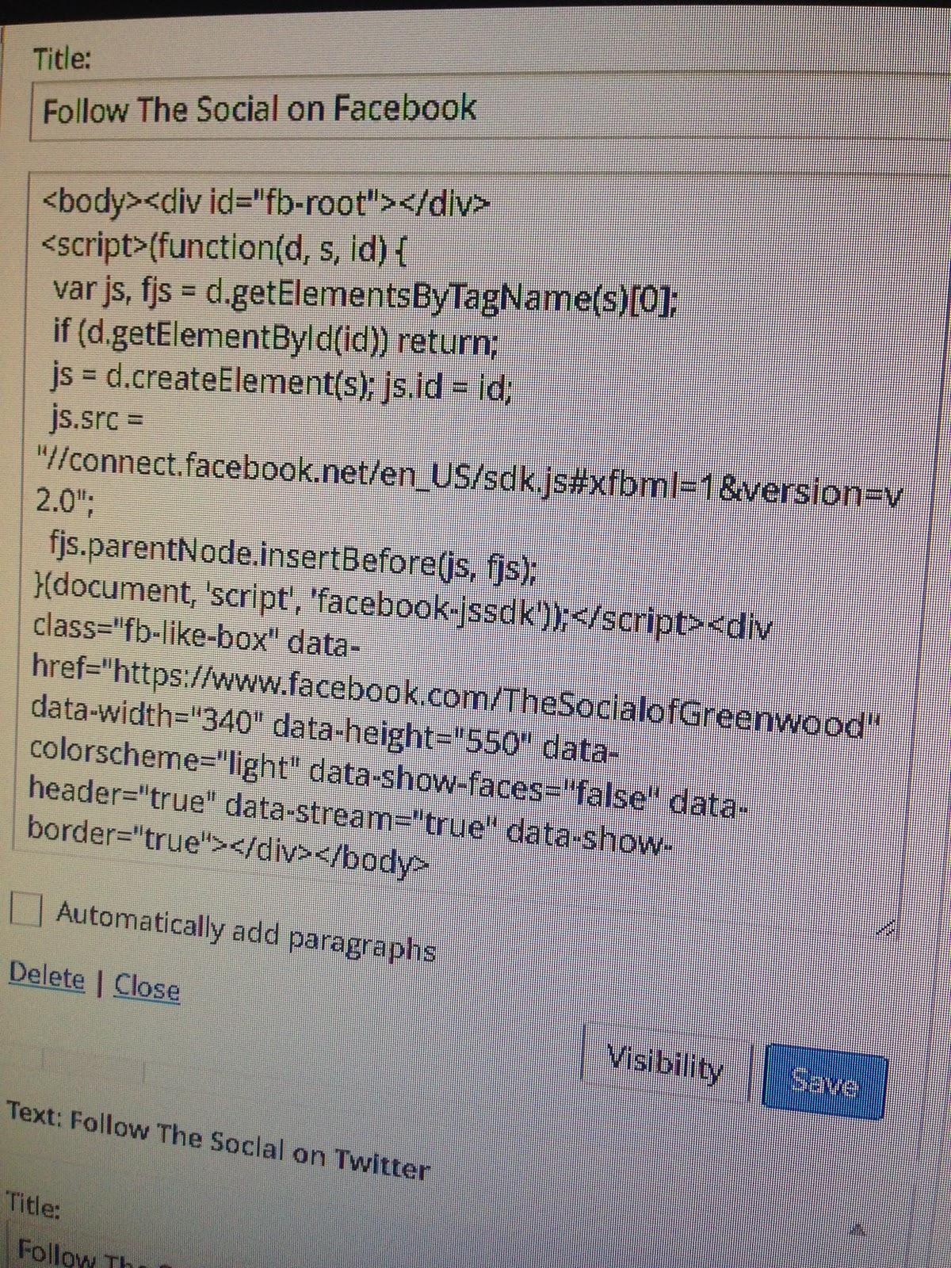

Slide 8
Widgets & Customization
The website has a customizable slider (time between slides, photos, captions, etc)
We imported photos into the slider and added links to pages on the site
Used short codes for various widgets (Facebook, Twitter, contact form, etc)
Added a customized sidebar with a function to allow different widgets to only appear on specific pages
Functions similar to if statements
Widgets we created:
A facebook widget linked to TSOG facebook page
A twitter widget linked to TSOG twitter account
A simple contact form that allows members and visitors to send messages to TSOG email account
And a donation button that is linked to TSOG paypal account
Added an interactive map with easy-to-use features
The map allows for normal functions (zoom, map type, etc)
This particular map allows users to find/print directions to or from TSOG without having to leaving the page
Utilized a plugin to implement a dynamic calendar
Options include: mobile-ready, viewing preferences, adding/editing events and more...

Slide 9
Future Work
Add functionality & content to design
Embedded video (what is TSOG all about?)
Scrolling content
Back-end work for volunteer/member management
Payments for membership and events
Contact management
Volunteer application through the website

Slide 10
Overall Experience
Provided applicable real-life experience
Rewarding to work with an excellent organization
Learned how to operate in a team dynamic

